Slide 1



Data Farmers
NEUROPOLIS
AI-Powered Crisis Intelligence System
Aggie Hacks ‘25
1
Apr 21, 2025

Slide 2



Overview
We have developed an AI-powered Crisis Intelligence System designed to help smart cities anticipate, manage, and respond to high-risk cascading disasters in real-time. This AI-powered crisis intelligence system transforms fragmented urban data into clarity, control, and coordinated action during multi-disaster scenarios.
Neuro (Brain) + Polis (City)
From Signal to Strategy
NeuroPolis uses a two-pronged approach
Predicts
Cascading
Disasters
Real-time
Misinformation
Detection
2

Slide 3

The Problem
In modern cities, one crisis triggers another. A flood knocks out power. The outage overwhelms hospitals. Panic spreads online, fueled by misinformation. What starts as a single event escalates into a city-wide emergency.
Crisis teams aren’t short on data—they’re drowning in it. Fragmented systems, delays, and fake news slow down response and cloud decision-making.
To stay ahead, cities need more than alerts. They need systems that connect the dots, forecast what’s next, and coordinate real-time action.
3

Slide 4





Our Solution
NeuroPolis is an AI-powered Crisis Intelligence System that acts as the brain of smart cities during emergencies—delivering real-time insights, predictive alerts, and trusted recommendations to manage cascading disasters with speed and clarity.
At its core, NeuroPolis fuses real-time signals and historical intelligence from sensors, hospital, utility logs, social media chatter, infrastructure networks, and climate records—transforming fragmented, multi-dimensional data into four action oriented capabilities for crisis response.
Predicting cascading disasters
Misinformation Detection
Live Risk Visualization
Decision Recommendation Engine
4

Slide 5






Our Approach
1.
Exploratory Data Analysis*
5.
Blockchain & Ledger Development
2.
Data Preprocessing
6.
Impact Analysis
3.
Data Visualization
7.
Technical Documentation*
4.
Model Building and Evaluation
8.
Feasibility Check & Optimization
Technology Stack
5
*Refer to appendix for details

Slide 6










How NeuroPolis works
From Signals to Strategy
Feature Importance
Cascade Disaster
Prediction
High Wind Speed (27%)
Intense
Rainfall
(26%)
+
Casualties
(8%)
Severity
(33%)
OR
+
Severity Support
(Pct > 70)
Blockchain Validation
(3 users)
Misinformation Detection
Sensor Match (±10 minutes)
Live Risk
Visualization
High Wind Speed (> 85 kmph)
Intense
Rainfall
(> 175 mm)
Severity Score
(> 8.0)
Decision Recommendation Engine
If: Flood Level > 75%
Then: Evacuate Zone
If: Road accessibility < 30%
Then: Reroute Traffic
If: Hospital Capacity > 90%
Reroute to Hospital B
6

Slide 7


Innovation Highlight
Intel Engine
Trust Ledger
Real-Time Forecasting
Risk Classification
Pattern Detection
Models: Random Forest, LightGBM, XGBoost
Verifies alerts & sensor readings
Logs misinformation
Enables time-stamped audit trails
Platform: HyperLedger Fabric Blockchain
This dual-core architecture transforms fragmented data into accountable, auditable, and actionable urban intelligence.
7

Slide 8
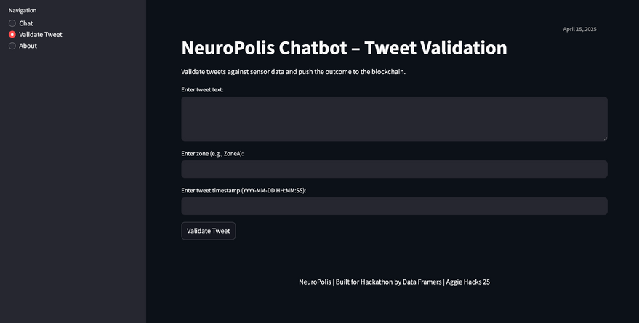
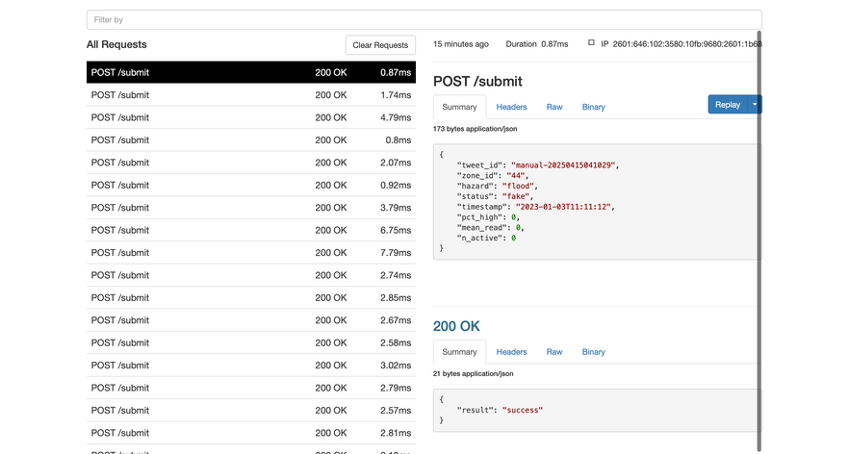
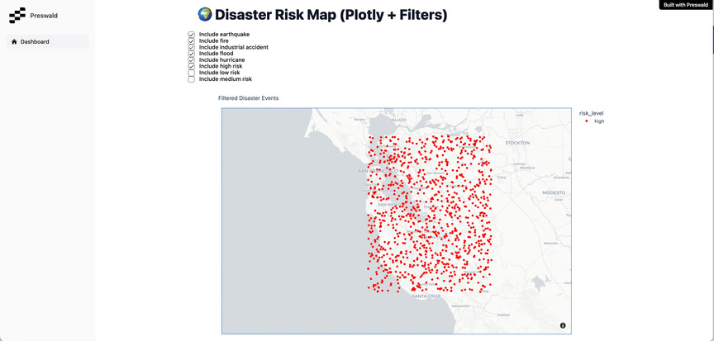
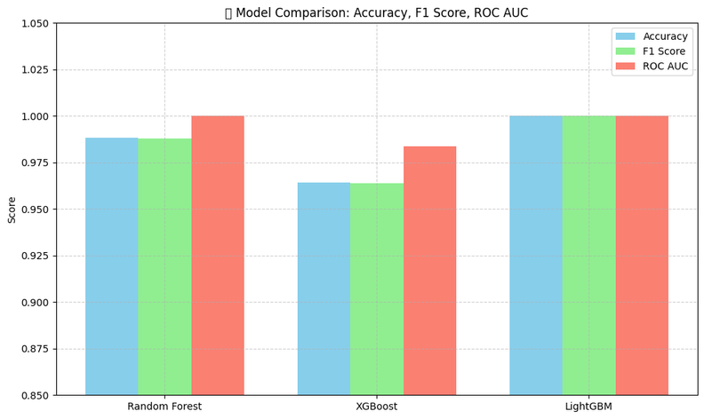
Visual Samples
Multi-purpose Chatbot
2. Blockchain-based Ledger
3. Live Dashboard
4. Model Comparison
8

Slide 9

Potential Impact
Simulation results using Hurricane Ian data* (2022) show the life-saving and cost-saving potential of NeuroPolis.
Fatality Rate Reduction
Economic Loss
Reduction
Improved
Response Time
Emergency Assets Efficiency
70%
$11bn
50%
60%
savings
Up to 70% fatality reduction through early warnings and proactive evacuations
~91 lives potentially saved in Hurricane Ian scenario
16% of total damages avoided through proactive infrastructure risk mapping
$11B in economic value preserved during Hurricane Ian
~50% faster response time via real-time incident tracking
Accelerated triage and aid delivery to flooded or inaccessible areas
60% increase in emergency asset efficiency during peak crisis
Smarter rerouting and resource reallocation through real-time system integration
*Estimates derived from modeled simulations using NOAA, EMDAT, and JFK weather datasets contextualized to Hurricane Ian (2022)
9

Slide 10




Thank you
DATA FARMERS
Rachel Guo
Chaitanya Khot
Adeyemi Olalemi
Avikalp (Avi) Karrahe
MSBA
MSBA
MBA
MSBA
10

Slide 11
Appendix
11

Slide 12

Documentation
Executive Summary
Disaster Prediction Model
Tweet Classification Model
Risk Visualization Dashboard
Decision Recommendation Module
Blockchain Ledger
Chatbot
Integration Blueprint
12

Slide 13
Resources
Blockchain-based fake news traceability and verification mechanism
Predicting Cascading Failures in Power Systems using Machine Learning
Artificial Intelligence Tools in Misinformation Management during Natural Disasters
Misinformation Detection: A Survey of AI Techniques and Research Challenges
Machine Learning for Disaster Risk Reduction – Review and Research Directions
Preswald
Hyperledger Fabric - Introduction
FloodNet NYC
Pandas
Streamlit
EBSCO (Hurricane Ian)
13

Slide 14
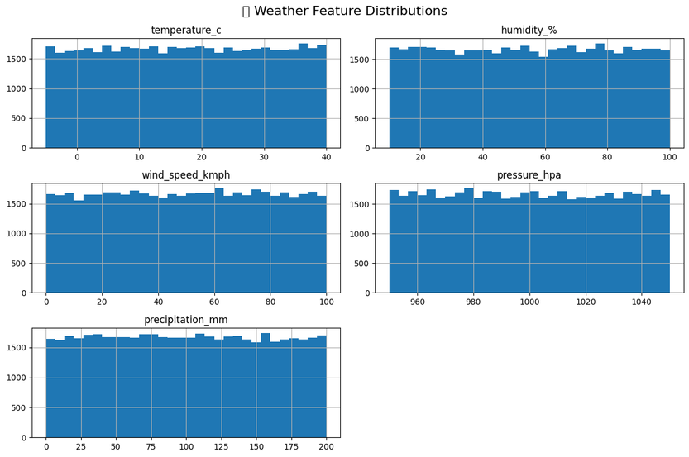
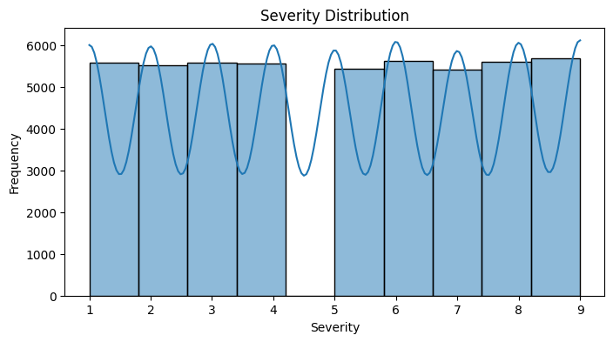
Data Exploration
Weather Feature Distributions
Severity Distribution
All categories have random noise and no inherent patterns
Severity scores are evenly distributed owing to synthetic data
14

Slide 15
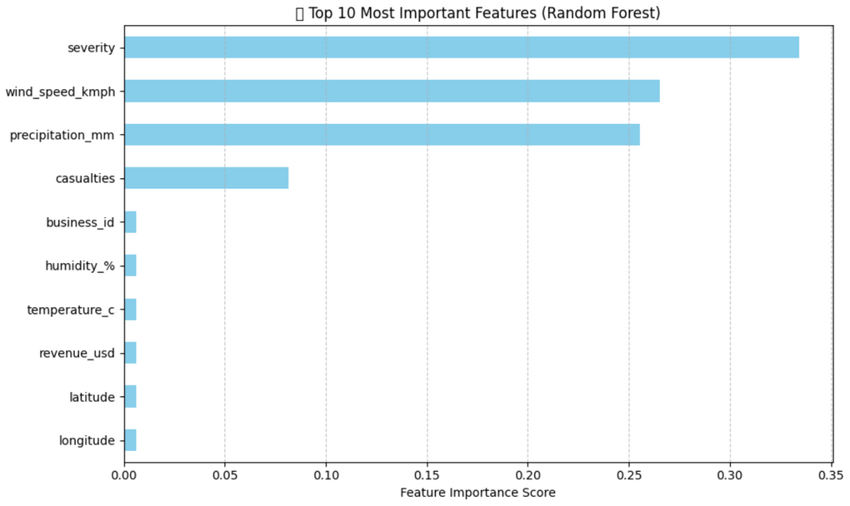
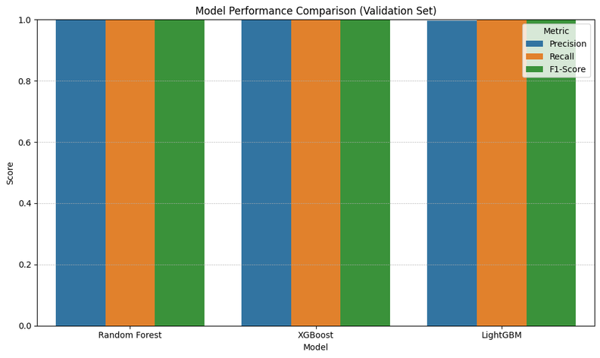
Data Exploration
Feature Importance
Model Comparison
Top Features: Severity, Wind Speed, Precipitation
Models have perfect accuracy owing to synthetic data
Results on real-world dataset may vary
15

Slide 16
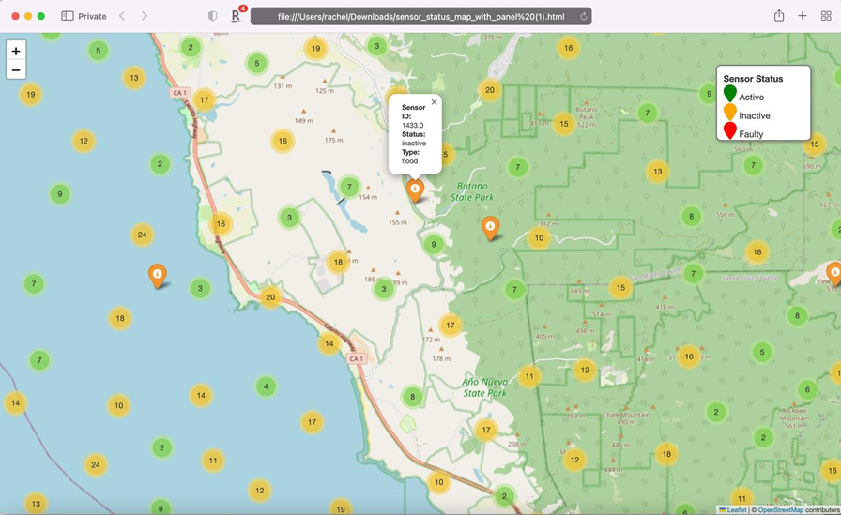
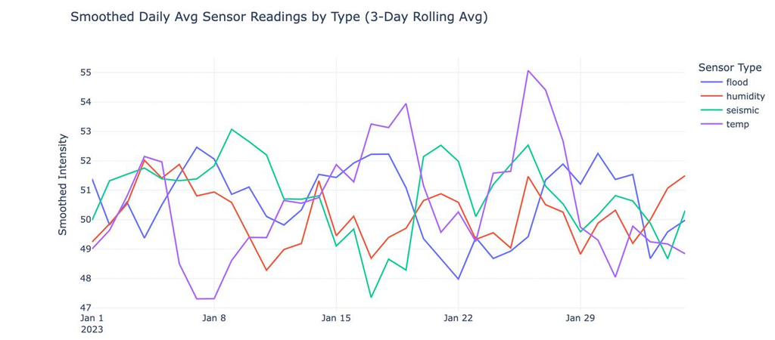
Data Exploration
Interactive Risk Map
Average Sensor Readings
Low-risk to High-risk classification of zones based on disaster type
Consistent scores across categories are expected owing to synthetic data
16

